Slide 1

Exercise 2 Activity

Slide 2
Exercise 2
Q1
Approaches:
Pros
Cons
Q2
Preferred approach:
Best practice criteria?
Assumptions?

Slide 3
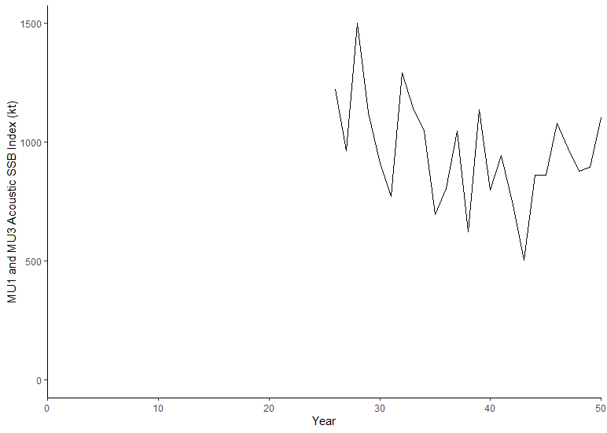
Exercise 2
Q4
Add plot here from R
Q3
Advice of LRP breach in short term
Q5
Stock Status in terminal year (year 50)? | How is uncertainty in stock status taken into account?

Slide 4
Exercise 2 Presentation Slide (to share at the workshop tomorrow)

Slide 5
Break Out Group Add Number
Indicator:
LRP:
Rationale:
Stock Status:
Add plot here
Submit all slides to Tim.Barrett@dfo.mpo.gc.ca when complete

